Slide 1
Toronto
vs
New York City
By Praveen Kumar Yalamanchili
Notes:
Comparison between City of Toronto and New York City

Slide 2
Comparing each city based on:
Analysis on the population Demographic Data available for each individual city
Putting together the Total population data in each city
Establish data segregation based on Gender
Watching the population Trendline for each city over the Years
Grouping the top Ethnic Groups in each of these Cities
Provide a map outline with neighborhoods spread across the city
Showcasing a view point from the cultural standpoint using FourSquare API.
Notes:
Background
From an Ancient show that it is characterized by population density, symbolic function, and urban planning, have existed for thousands of years. In Modern day(Today) Cities generally have extensive systems for housing, transportation, sanitation, utilities, land use, and communication. Their density facilitates interaction between people, government organizations and businesses, sometimes benefiting different parties in the process.
A city is distinguished from other human settlements by its relatively great size, but also by its functions and its special symbolic status, which may be conferred by a central authority. The term can also refer either to the physical streets and buildings of the city or to the collection of people who dwell there, and can be used in a general sense to mean urban rather than rural territory.
And mostly Cities have become a main target areas for Business Employment and many other sources of livelihood for individuals migrating from different parts of the world.
Business Problem
As we see many people migrate to different cities in the world for better livelihood, life, employment, entertainment etc.
Our take in this project is to be able to compare two different cities based on population , ethnicity and similarity of neighborhoods based on the FourSquare Venues Data.
Upon successfully analyzing the data, one should be able to see the similarity or dissimilarity between New York City and the City of Toronto from the perspective of Population diversity, Ethnicity and neighborhood venue data.
Target Audience:
Target Audience would be any person or business who would be interested in comparing the Cities New York and Toronto based on their Population Diversity, Ethnicity and Neighborhood Data using FourSquare API.

Slide 3
Data Gathering and cleansing
Population Demographic Data:
City of Toronto Population Demographics and Ethnicity data:
https://en.wikipedia.org/wiki/Demographics_of_Toronto
New York City Population Demographic Data :
https://en.wikipedia.org/wiki/Demographics_of_New_York_City
Population by Gender data :
https://newyork.areaconnect.com/statistics.htm
Location Data:
FourSquare API
https://api.foursquare.com/v2/venues/explore?&client_id={}&client_secret={}&v={}&ll={},{}&radius={}&limit={}'.format(CLIENT_ID,VERSION,LATITUDE,LONGITUDE,radius,LIMIT)
Notes:
Sources of Data:
Population Demographic Data for the Cities were taken from below Sources
City of Toronto Population Demographics and Ethnicity data:
https://en.wikipedia.org/wiki/Demographics_of_Toronto
New York City Population Demographic Data :
https://en.wikipedia.org/wiki/Demographics_of_New_York_City
Population by Gender data : https://newyork.areaconnect.com/statistics.htm
Location Data:
FourSquareAPI :
https://api.foursquare.com/v2/venues/explore?&client_id={}&client_secret={}&v={}&ll={},{}&radius={}&limit={}'.format(
CLIENT_ID,
CLIENT_SECRET,
VERSION,
LATITUDE,
LONGITUDE,
radius,
LIMIT)

Slide 4
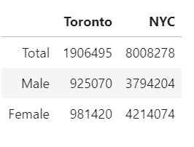
Total Population with Gender Segregation:
By looking at the Total Population Data,
one can easily state that New York City
as densely populated than the City of
Toronto i.e., NYC Total pop. is at ~8008278
and Toronto Total Pop. is at ~1906495 ,
which states that NYC is ~4 times densely
populated that City of Toronto.

Slide 5
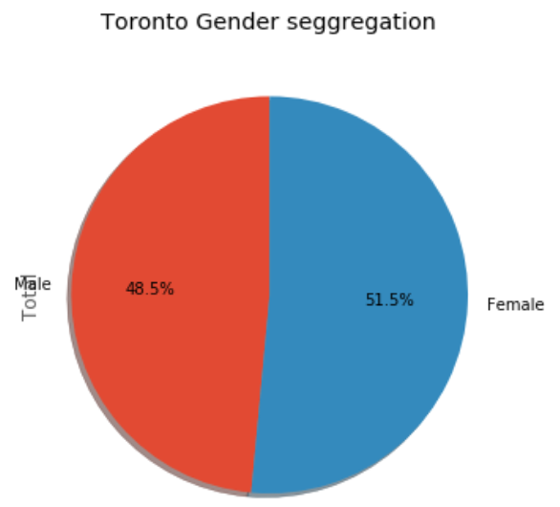
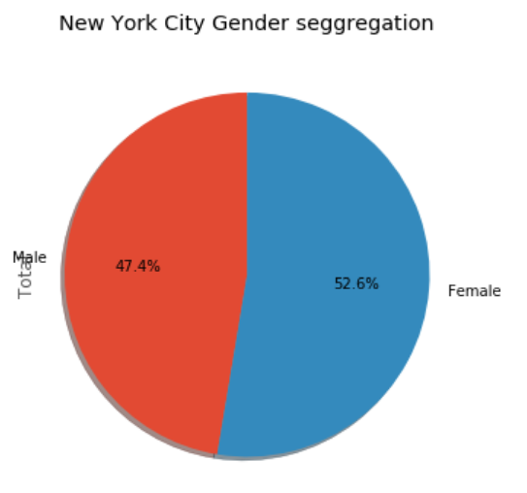
Gender Segregation/Ratio:
When we see the above pie charts for both the Cities we see that both the Cities were almost equally biased based on Gender ratio of the cities, even though from the Population Data, one can easily state that New York City as densely populated than the City of Toronto.
City of Toronto
New York City

Slide 6
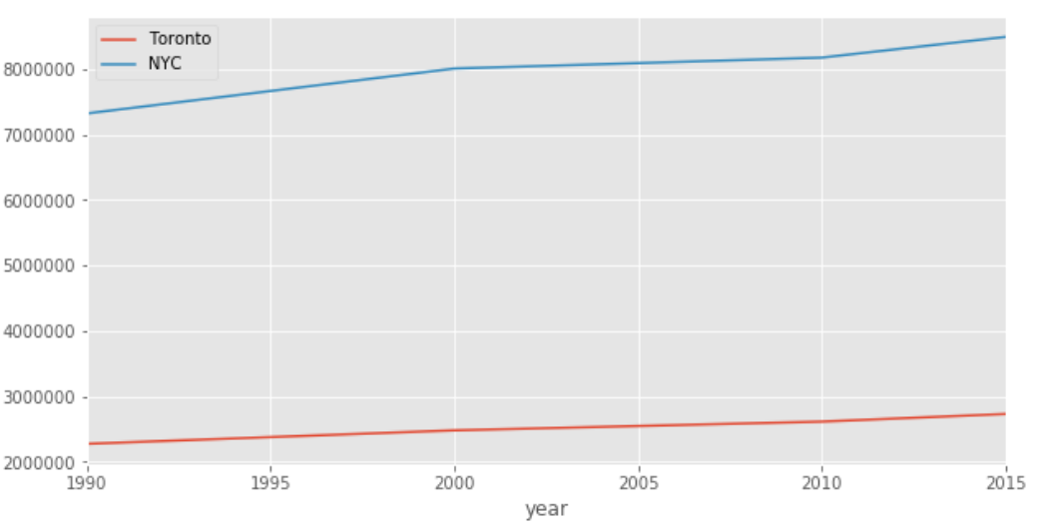
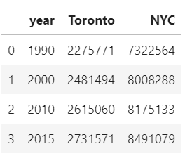
Population History Trend chart b/w 1990 - 2015
Historical Data b/w 1990 - 2015
(with census for every 5 years)
Toronto vs New York City Population Hist. Trend Line

Slide 7
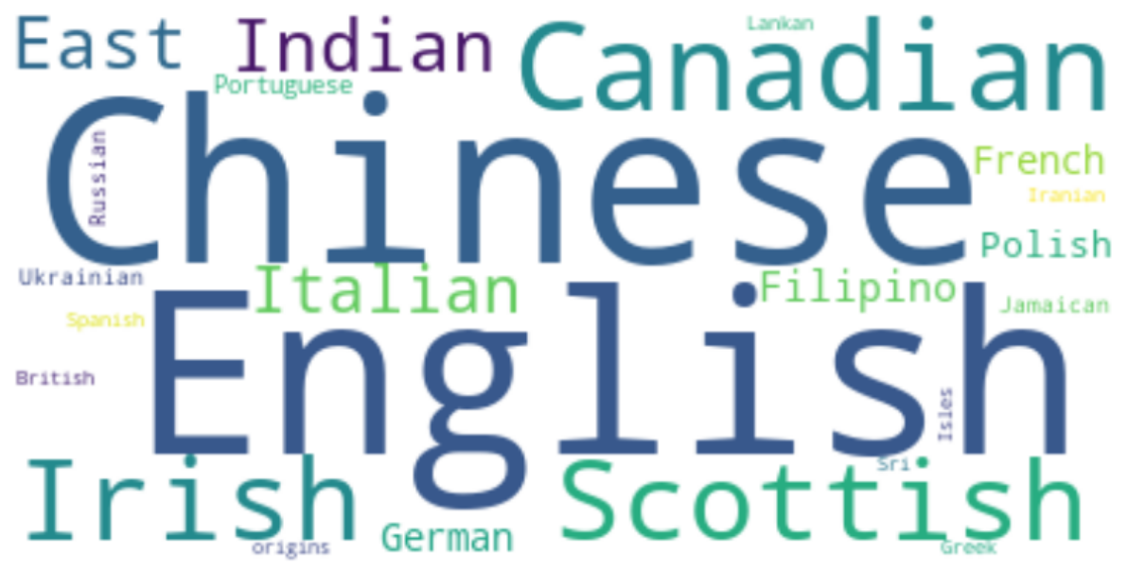
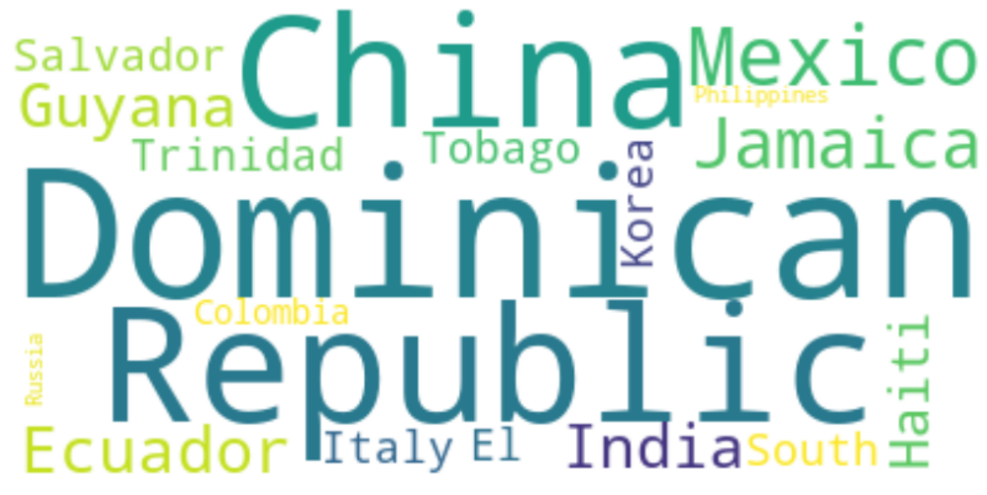
Ethnicity based on Country of Origin
City of Toronto
New York City
Notes:
From the technical standpoint we see the Primary ethnic groups present in the City of Toronto are of the Origin Chinese,English,Canadian,Irish,Scottish,East Indian, Italian, Filipino,German,Polish etc.,
And also we can see the top ethnic groups present in the New York City were of the origin mainly from Countries like Dominican Republic, China, Mexico, Jamaica, India,Ecuador, Guyana, India,El Salvador, Trinidad & Tobago, Korea, Haiti, Italy etc., as depicted in the figure above.
When we compare both cities, we see that a different set of Ethnic groups present in the Cities one comprising more from Europe end(like English, Scottish, Italy, Filipino, French etc.,) , where the other City(New York) mostly comprise individuals from China, Dominican Republic, Mexico, Jamaica, Ecuador, Guayana etc.,

Slide 8
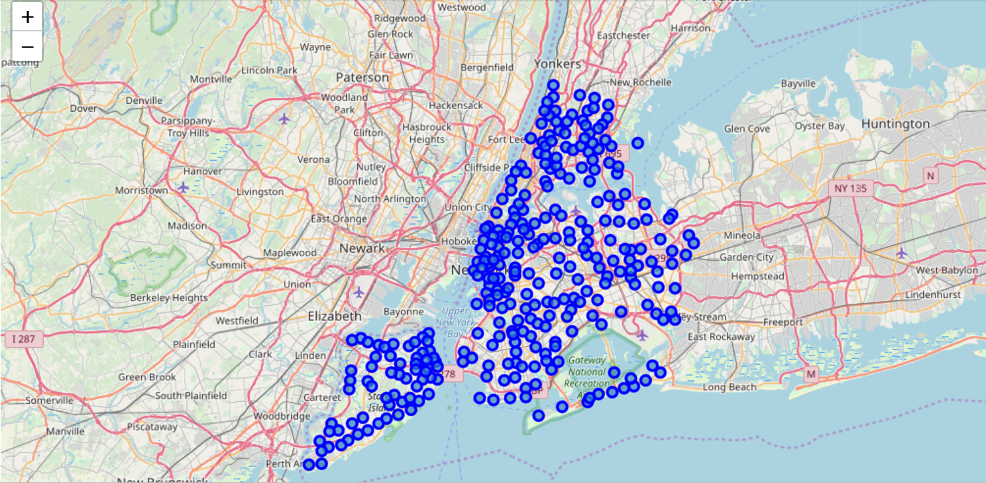
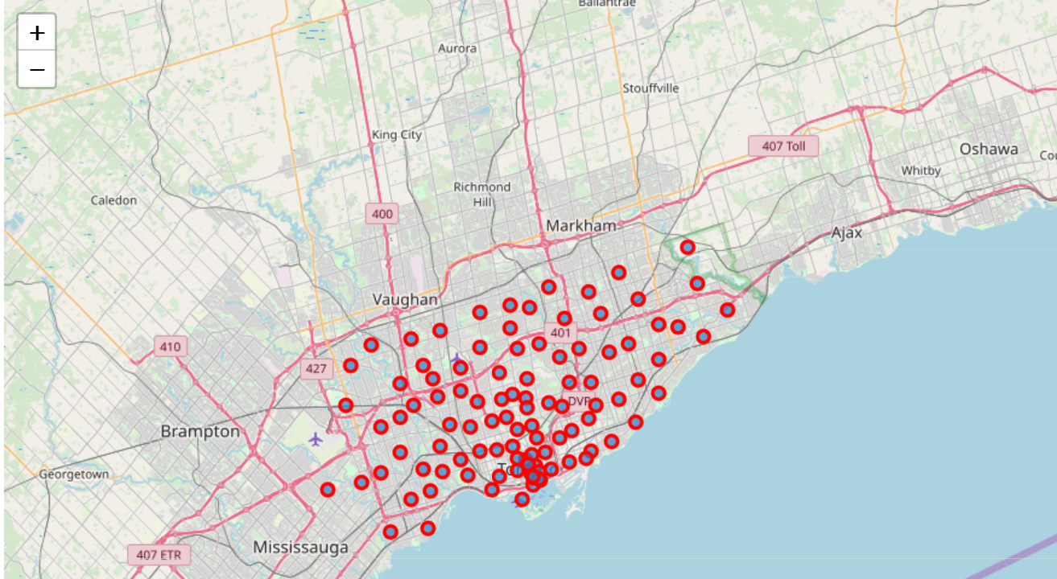
Folium Map representation of the each City with neighbourhoods
New York City
City of Toronto
Notes:
We can see how densely populated the New York City really is and the number of neighborhoods present in it are ~306 , which in itself states that New York City is a very highly populated City with a lot of footprints of people from different countries situated in a number of neighborhoods placed across the City. When we have a look at the City of Toronto , geographically as we see on the map below Toronto seems to be a much smaller City than New York and definitely a far less populated with just ~103 neighborhoods (merely with a population of about 1906495 ), which is about 1/3rd of the total neighborhoods present in the New York CIty.
The above data is completely extracted from the data sources mentioned in the “Data Gathering and Cleansing” Section where we put together the data already available online about the Neighbourhood/Borough details with exact Location coordinates for mapping of the above Folium Maps for each City, individually depicting the neighborhoods present in them.
By Comparing the Folium Maps above for each of the cities listed, we can conclude that the area or the Geographical expansion of the Cities, New York City is more when compared to the City of Toronto.

Slide 9
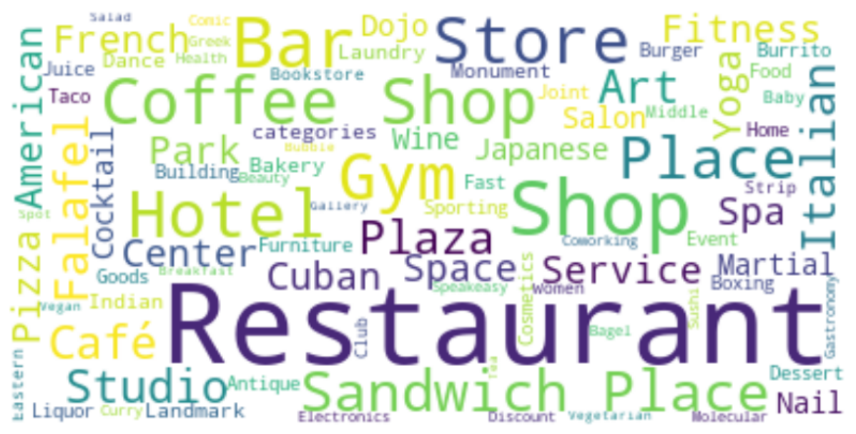
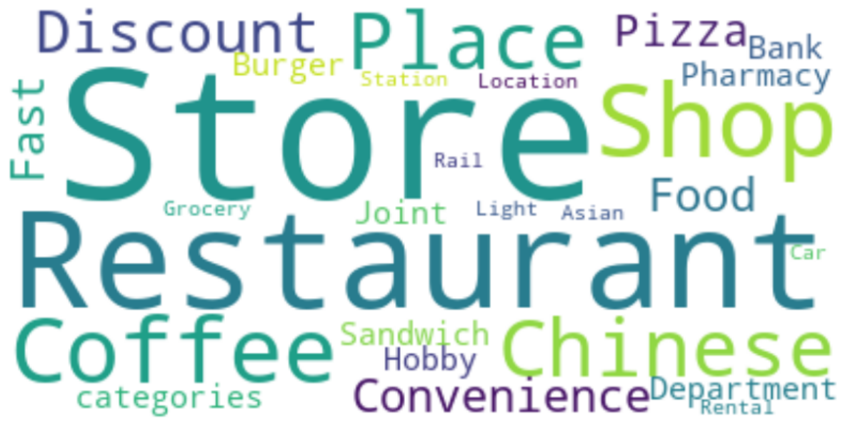
Most Common Types of venues in each city using FourSquare Location Data
New York City
City of Toronto
Notes:
A Word cloud form of the location data showcasing the Variety of Venues present in the New York CIty . Top 100 venue data received as part of the FourSquare API data extraction. We have limited the results to 100 as it has retrieved a lot of Venue data for New York City
These pictures would be representation of the variety of venues present in the heart of the City of Toronto . The data we have received is just around 5 to 7 venues when we keep the radius as 500 meters from the Toronto Coordinates, so we have increased it to 1000 meters to present a better picture of the Venue data for Toronto alone(still the number venues we had as only ~26, which is , when compared to New York City is a fraction the total venues present in the NYC).

Slide 10
Conclusion and Future Direction :
Both cities differ vastly based on Population Demographics
Population Density of NYC is much higher than the Toronto
Population history over the years and almost equal Sex Ratio (Male vs Female)
Ethnicity showed a variety of people from different countries of origin present in each city
NYC: Dominican Republic, China, India, Jamaica, Ecuador, Korea, Guyana etc.
Toronto: English, Canada, China, Germany, Italy, French etc..
Future Scope:
A variety of complex and advanced analysis like the idea putting together a variety of data say Crime Data, Employment rate in those cities, Status of the people living in the cities, Amenities available, Real estate availability..etc., there will be a million possible things we can put together
Possibilities lie within one's own imagination /creativity of using the data at hand
Notes:
Our analysis shows that there is a huge difference between the cities in terms of Population Demographics , when compared to New York City , Toronto seem to be very less populated than NYC, though the gender ratio seems to be of almost the same ratio(b/w Male vs Female).
When we look at the population history of both the Cities It trended similarly, upwards in the trend chart presented above. Although we see a huge gap in between population density that both the cities possess.
Ethnicity by country of origin of the people in both the Cities share a variety of ethnic groups like the NYC mostly consists of the Dominican Republic, China, India, Jamaica, Ecuador, Korea, Guyana etc., Where as the Toronto's Ethnic groups consists of people from English, Canada, China, Germany, Italy, French etc..
Upon looking at the location data from FourSquare we found that there were only fraction of venues in Toronto (~7) than compared to NYC (>100) , which obviously states that NYC is a very renowned City in terms of population & cultural diversity , ethnicity, Business.
By the above factors we can also state that New York City has far more opportunities than Toronto in terms of Business/Shifting to another City, if you were looking to shift to a new City for Employment opportunities. We see that it’s a pretty good option to shift to the NYC as the analysis suggests they got more opportunities than in Toronto, In a manner , the above data can suggest a person/individual to decide the top categories based on population demographics .
Now the decision is left with the Individual who compare the data available for both of these cities and decide whether to shift to a New City or venture in suitable one in these cities.
Purpose of this project was to compare two cities and find the differences and mostly seeking to find a variety of differences in terms of population density , ethnicity, Business availability. Final decision has to be made by individuals/stakeholders based on specific characteristics of neighborhoods and locations in the city, taking into consideration additional factors like attractiveness of each location, Educational quotient, real estate availability, prices, social and economic dynamics of every neighborhood etc.
Future Scope:
Think the analysis presented above shows only a short fraction of the many varieties of data that an individual/Business can gather and put it to a greater realistic purpose, like the idea that we can put together a variety of data say Crime Data, Employment rate in those cities, Status of the people living in the cities, Amenities available, Real estate availability..etc., there will be a million possible things we can put together and put a real case for use of such data in a very constructive way useful for future generations of possible improvements, challenges future predictions on employment, Crime patterns, looking at possible improvements in livelihood of the people living those cities based on the actual/real time data & many more.
I leave it to your imagination as the possibilities are vast...

Slide 11
Thank You

